Slide 1

Sentiment Analysis of Twitter Data CISC520-50 (FALL 2016):Data Engineering and Mining
Dean D’souza
H.U. ID: 168424
Lecturer: Majid Shaalan, PhD.
Assistant-Lecturer: Raja Shanmugavelan

Slide 2
Agenda
Project Goal
Definitions
Data Exploration
The Model
Evaluation
Conclusion
Future Work

Slide 3
Project Goal
The primary goal of the project is to create a Classifier which can accurately classify Twitter posts (or Tweets)
Sub-goals include:
Build a Naïve Bayes Classifier
Build a Decision Tree Classifier
Compare results

Slide 4
Definitions:
Sentiment Analysis: also known as opinion mining is an important field in Computer Science which focuses on obtaining information from text data, usually in the form of attitude of the author with regards to a topic or the overall polarity of the document. [1]
Tokenization: the process of breaking down a collection of characters or a string into smaller parts known as tokens.
Part-of-Speech (POS) tagging: involves correctly identifying what part of speech each word token belongs to.
Lexical Diversity: measures how many different words are in a text.

Slide 5
Definitions:
Collocations: frequently occurring pairs of words too frequent to be due to chance. [4]
Accuracy: a less-specific measure which indicates the proportion of the testing set which was correctly tagged. [6]
Precision: measures the exactness of the classifier. [7]
Recall: measures the completeness or sensitivity of the classifier. [7]

Slide 6
Data Exploration
Data obtained from Sentiment140 [3]
Original dataset - 1,600,000 records
Sample – 7200 records (3600 positive & 3600 negative)
Fields (or attributes):
Tweet polarity
Tweet ID
Tweet Date
Tweet Query
Author
Contents

Slide 7
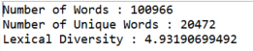
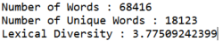
Data Exploration
Lexical Diversity (with stopwords):
Lexical Diversity (without stopwords):

Slide 8
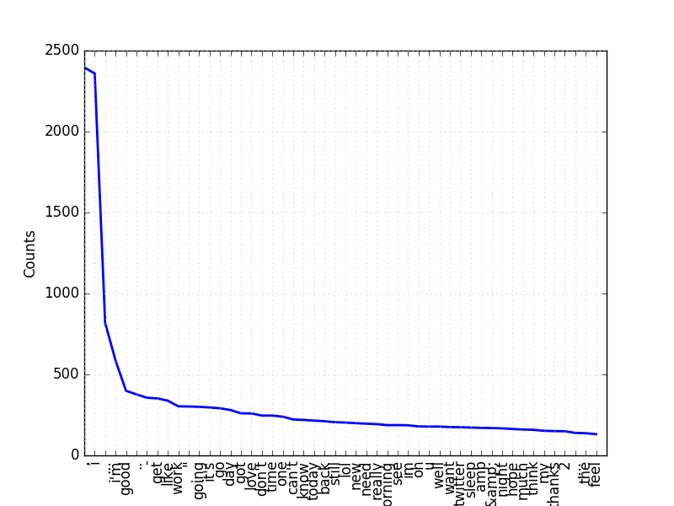
Data Exploration
Frequency Distribution of words:
‘,’ - 2450
‘l’ – 2400
‘…’ – 1300

Slide 9
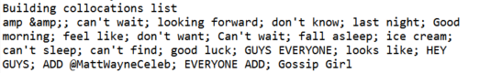
Data Exploration
Collocations:

Slide 10
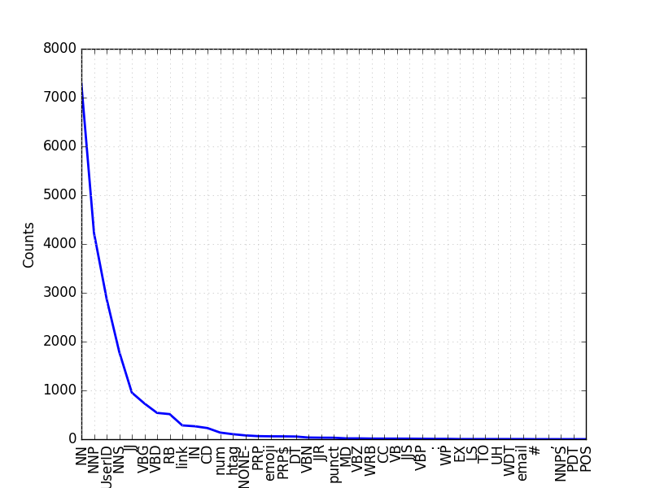
Data Exploration
Frequency Distribution of POS tags:
NN (Noun) - 7000
NNP (Proper Noun) – 6000
UserID - 3000

Slide 11
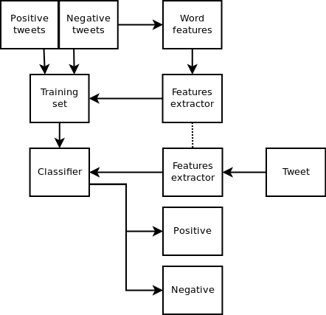
The Model
Basic steps:
Extract features
Apply features to Training data
Train Classifier
Apply features to Testing data
Classify using Classifier

Slide 12
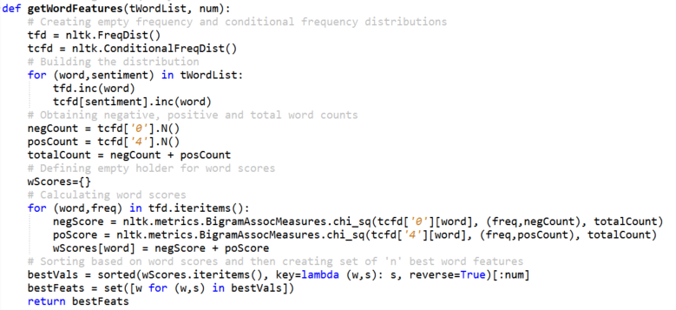
The Model
Dictionary:

Slide 13
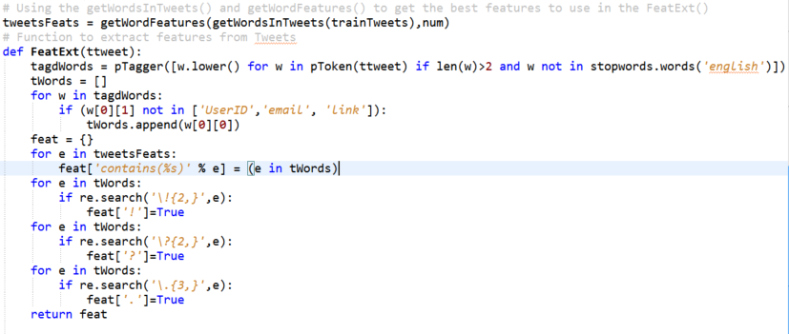
The Model
Feature extraction:
Tokenization (using pTokenizer)
POS tagging (using pTagger)
Filter words
Add to features

Slide 14
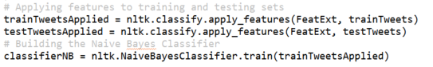
The Model
Apply features and build:

Slide 15
Evaluation
Two Ratios of Training and Testing data:
75:25
80:20
Evaluating considered 10, 100, 1000, 1500, 2000, 2500 and 3000 most important features

Slide 16
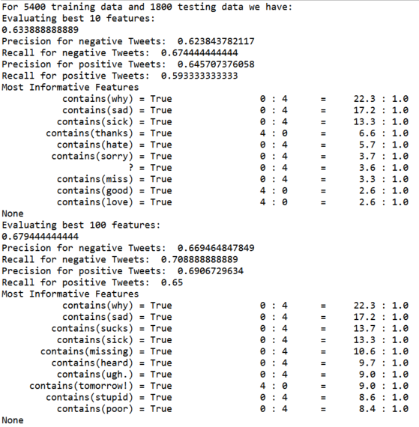
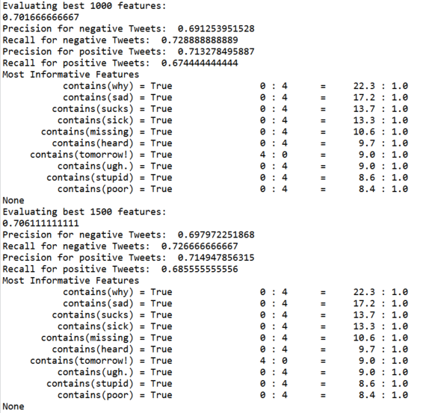
Evaluation
Naïve Bayes Classifier ( 75:25 ):

Slide 17
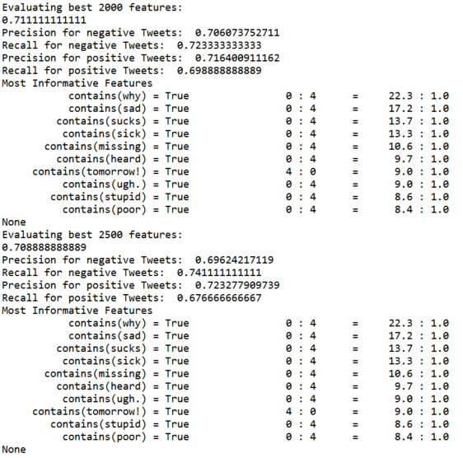
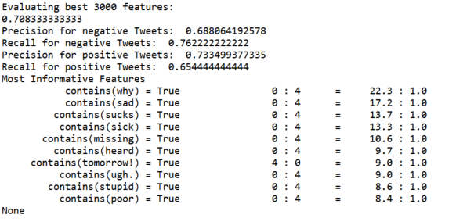
Evaluation
Naïve Bayes Classifier ( 75:25 ):

Slide 18
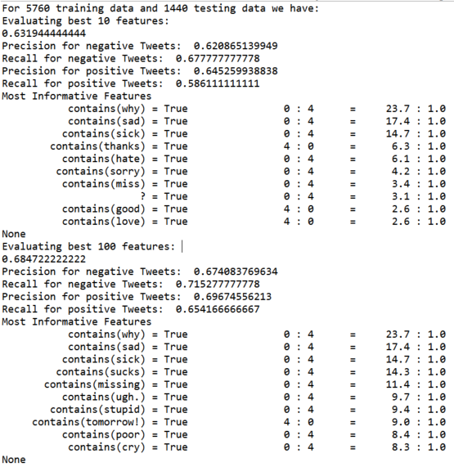
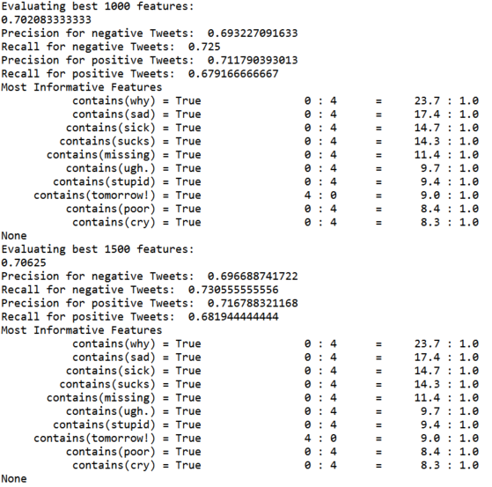
Evaluation
Naïve Bayes Classifier ( 80:20 ):

Slide 19
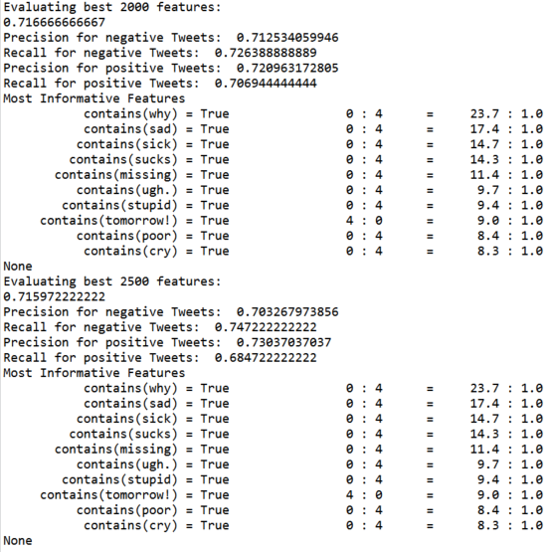
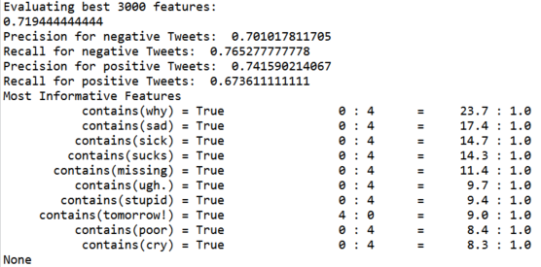
Evaluation
Naïve Bayes Classifier ( 80:20 ):

Slide 20
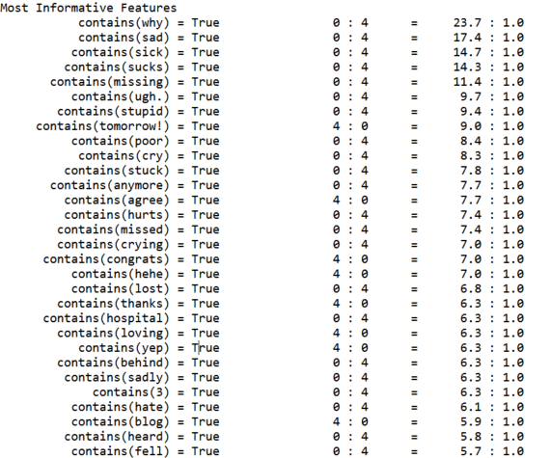
Evaluation
Naïve Bayes Classifier (final) Most important features:

Slide 21
Evaluation
Decision Tree Classifier
Runtime over 3 hrs (for each value of most important features)
Not Accurate
Number of crashes

Slide 22
Conclusion
Naïve Bayes Classifier successfully built
Accuracy of roughly 72%
Decision Tree Classifier unsuccessful
Comparatively large execution time
No clear advantage

Slide 23
Future Work
Improve Tokenizer (eg. ‘:)…..:/….8)’)
Improve POS tagger
Use Decision Tree Classifier to build feature set
Possible application to Mood Detection or Degrees of Sentiment

Slide 24
Thank You

Slide 25
References
“Sentiment Analysis”, Wikipedia, (https://en.wikipedia.org/wiki/Sentiment_analysis)
“Natural Language Processing”, Wikipedia, (https://en.wikipedia.org/wiki/Natural_language_processing)
“Sentiment140 – For Academics”, Sentiment140, (http://help.sentiment140.com/for-students)
“Natural Language Processing with Python”, Steven Bird, Ewan Klein, and Edward Loper, O'Reilly Media, 2009, (http://www.nltk.org/book_1ed/)
“Twitter Sentiment Analysis using Python and NLTK”, Laurent Luce, January 2nd 2012, (http://www.laurentluce.com/posts/twitter-sentiment-analysis-using-python-and-nltk/)
“Second Try: Sentiment Analysis in Python”, Andy Bromberg, February 14,2013, (http://andybromberg.com/sentiment-analysis-python/)
“Text Classification for Sentiment Analysis – Precision and Recall”, Jacob(streamhacker.com UserID), May 17,2010, (http://streamhacker.com/2010/05/17/text-classification-sentiment-analysis-precision-recall/)
“OPINION MINING USING DECISION TREE BASED FEATURE SELECTION THROUGH MANHATTAN HIERARCHICAL CLUSTER MEASURE”, JEEVANANDAM JOTHEESWARAN, DR. Y. S. KUMARASWAMY, Journal of Theoretical and Applied Information Technology, December 10,2013, (http://www.jatit.org/volumes/Vol58No1/8Vol58No1.pdf)

